Slide 1


Social Entrepreneurship in Consumer Well0-being Handbook
Revised June 2021

Slide 2
How to Use the Handbook
To understand the major
To consider possible careers
To review the course requirements
To plan your program of study
Notes:
Applications for admission to Social Entrepreneurship will be accepted up to the third Friday of the Fall and Spring semesters.
Students who are planning to major in Social Entrepreneurship and wish to be advised by a Social Entrepreneurship advisor prior to acceptance to the major must be designated as an intended Social Entrepreneurship major.
If you are interested in Social Entrepreneurship as a major, you will need to complete the application for Social Entrepreneurship found at the following URL:
If you have specific questions, please contact Dr. Dee Warmath (warmath@uga.edu) or Mr. Ahmaud Templeton (ahmaud@uga.edu).

Slide 3
The Social Entrepreneurship Major
Social Entrepreneurship equips students with the process, skills, and knowledge they require to shine the light and solve the riddle for a variety of wicked, interdisciplinary consumer problems in society. Shining the light involves bringing attention to the problem that motivates action. Solving the riddle involves design, implementation, and evaluation of innovative approaches.
The major is built on the concept of design thinking for consumer well-being. The core courses in the major provide process and skills that can be applied across a wide range of topics. Beyond these five courses, students majoring in Social Entrepreneurship choose from courses across UGA to build expertise in a particular area of interest. We call this area of interest the student’s “substantive or content area.” For example, a student may want to focus on building financial well-being as their substantive area. Perhaps their career goal is to establish a fin tech start up to improve financial well-being for their target audience. They might choose courses related to financial decision making, behavioral economics, psychological and/or sociological theory, and game design.
Design thinking for consumer well-being + expertise in a particular area of interest = preparation to make a difference.
Upon graduation with a major in Social Entrepreneurship, the student will be prepared to articulate their chosen content area in relation to their career objectives, to describe the purpose of social entrepreneurship, and to apply the methods and process of social entrepreneurship.
Requirements for admission include:
Cumulative GPA of 2.0 or better
Completion of Core Areas I-V
GPA of 2.8 or better in Areas I, II, III and V
Statement describing career goals and proposted substantive area of study to support career goals
Since Social Entrepreneurship is a high-demand major, the number of students admitted in any given semester will be determined by the available number of slots. Thus, meeting the minimum requirements does not guarantee acceptance into the major.

Slide 4

Potential Careers
What might you do with a Social Entrepreneurship major?
Start a non-profit organization
Take a corporate position
Work for a foundation
Launch a company with a conscience
Make a difference in corporate social responsibility
Become an innovator
Who hires Social Entrepreneurship graduates?
AT&T | Bloomingdale’s | Home Depot | Oracle | Insight Global | Nordstrom
The University of Georgia | Publicis Worldwide | Northeast Health District |
Avaline |
What are the outcomes of recent graduates?
67% Employed Full-Time** | 13% Employed Part-Time | 8% Internships | 4% Attending Grad School

Slide 5
Major Requirements
Area V:
Perspectives Course
  Purpose is to build capacity to see a situation from multiple perspectives
  Satisfy by selecting any 2000+ course that examines a topic from multiple perspectives
Writing Course
  Purpose is to build capacity to articulate ideas effectively
  Satisfy by selecting any “W” suffix designated course
Professional Innovation
  Purpose is to build skills necessary for your intended career
  Satisfy by selecting any course that teaches a skill relevant to your professional interest
Required Courses:
Core Course Sequence
  FACS 2000/2000E: Introduction to Family and Consumer Sciences
  FHCE 4010/6010: Introduction to Social Entrepreneurship (Fall only)
  FHCE 4011/6011: Social Entrepreneurship: Strategic Storytelling (Spring only)
  FHCE 4051/6051: Social Entrepreneurship: Social Impact Communication (Fall only)
  FHCE 5011/7011: Social Entrepreneurship Capstone (Spring only)
Substantive/Content Area Courses:
  Choose 15 hours in your content area
  These credit hours can come from any UGA college and should build expertise in an area of interest
Other Courses
  Choose 9 additional hours of FACS coursework (for example, you might complete the Applied Consumer Analytics sequence of courses)
  Choose 12 hours as major or content area electives
  Choose 13 hours of general electives

Slide 6
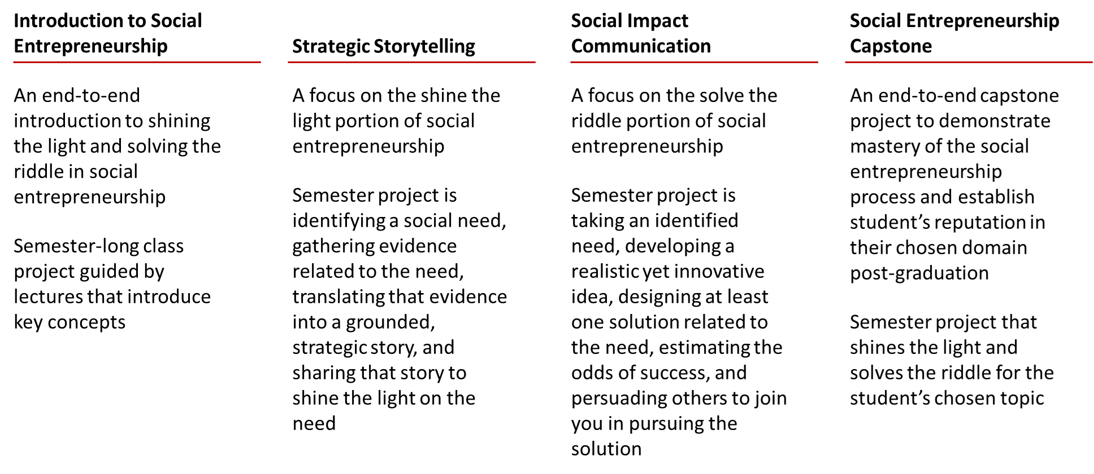
Your Program of Study
The core course sequence:
Identifying your substantive/content area:
Most students enter the major with a general sense of their substantive or content area. By exploring potential areas of interest, the career options available, and the courses that might support their interests, the student curate their substantive area.
It is important that the student graduates with their core social entrepreneurship skills and expertise in the area or topic in which they would like to build a career. Your advisor and professors are available to help you explore what this area might be.
Finding the right courses for you:
The most unique feature of this major is the flexibility it provides. Rather than completing a list of pre-determined courses, students in Social Entrepreneurship design their own major around their interests and the career opportunities they see. With that flexibility comes the responsibility to consider the collection of courses taken. The more intentional the selection of courses, the better prepared the student will be to make a difference post-graduation.
Students are free to take courses from any UGA college. They will work with their advisor to establish criteria for selecting courses. These criteria will be based on student interests and career objectives as well as the availability of courses.

Slide 7
Advisement Form
Name:
81X ID #
Desired Graduation Date:
Hours Earned:
E-mail:
Phone:
Content Area
Please indicate any major(s) that you are pursuing in addition to Social Entrepreneurship:
2nd Major
3rd Major
4th Major
Core Courses
 | Course | When Taken/Planned
1. | FACS 2000/2000E
2. | FHCE 4010/6010
3. | FHCE 4011/6011
4. | FHCE 4051/6051
5. | FHCE 5011/7011
Content Area Courses (15 hours)
 | Course | When Taken/Planned
1.
2.
3.
4.
5.

Slide 8
Advisement Form
Area V
 | Course | When Taken/Planned
1. | Perspectives
2. | Writing
3. | Professional
Additional FACS Coursework (9 hours)
 | Course | When Taken/Planned
1.
2.
3.
Major Electives (12 hours)
 | Course | When Taken/Planned
1.
2.
3.
4.
General Electives (13 hours)
 | Course | When Taken/Planned
1.
2.
3.
4.
5.

