Slide 1
Investing and Behavioral Economics
Swarn Chatterjee
Department of Financial Planning, Housing, & Consumer Economics
University of Georgia

Slide 2
Topics for today’s discussion
Financial Capability
Behavioral Economics: The role of psychology in financial decision making
Investing principles

Slide 3
What is Financial Literacy?
Perceived Competence
  How well someone can access, understand, and apply financial information
Measured Competence
  A person’s ability to access, understand, and apply financial information when measured on a scale
(Nicolini, Cude, & Chatterjee, 2013)

Slide 4
What is financial capability
an individual’s capacity based on knowledge, skills, and access, to manage financial resources effectively
President’s Council on Financial Capability
Resources
Federal Government’s Resource Guide for financial capability
  https://www.whitehouse.gov/sites/default/files/final_toolkit_k-12.pdf
  https://www.whitehouse.gov/webform/financial-capability-toolkit-tell-us-what-you-think
Jumpstart Coalition
  http://www.jumpstart.org/assets/files/2015_NationalStandardsBook.pdf

Slide 5
Our View of the Financial World
The Concept of ‘Lenses’
  Risk tolerance is a mediating factor
  Knowledge
    Education
    Training
    Experience
Current Environment
Recent Events

Slide 6
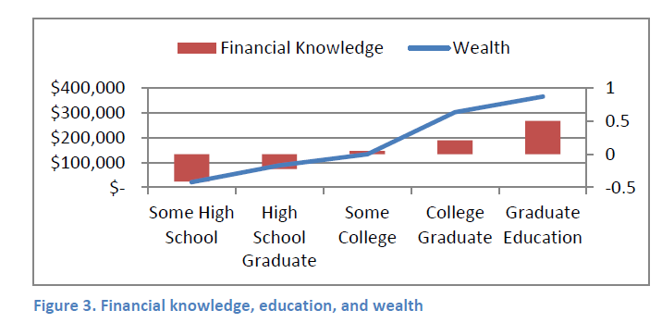

Why financial knowledge matters?
Adapted from Grable & Palmer (2015)

Slide 7
Why does financial education matter?
Policies resulting in increased individual responsibility in saving for one’s retirement, managing one’s finances
Increasing longevity
Mandatory Auto insurance, health insurance etc.
Complex financial decisions are being shifted from institutions to individuals

Slide 8
Characteristics of financially capable individuals
Self-regulation
  Self-efficacy (Confidence)
  Self-Control
Experience
Information (Education)
Interest
Being involved/engaged in consciously making financial decisions
Altruism

Slide 9
Pathways to wealth
Keeping good financial records
Spending less than is earned
Maintaining appropriate risk management strategies
  Insurances
  Emergency funds
Saving money on a regular basis

Slide 10
Savings & Investments
How can we define savings?
How is investing different from saving?

Slide 11
Saving vs. Investing
How much do we need to save?
Where should we invest our money?

Slide 12
Are people saving enough?
https://research.stlouisfed.org/fred2/series/PSAVERT
http://www.cnbc.com/id/102317918

Slide 13
Applying Behavioral Economics to Improve Financial Well-being
Save more tomorrow (SMT™) program
  Thaler & Benartzi, 2004
Using psychological counseling techniques to reduce financial stress

Slide 14
Revisiting our discussion on risk tolerance
What is risk tolerance?
What is risk capacity?
Why is this important?

Slide 15
Why is financial risk tolerance a big deal?
Investments in different asset classes require different levels of risk taking
The financial asset classes that are more risky have to offer higher yields (returns) to remain competitive
The amount of return we can generate from the market is tied to the amount of risk we take
The amount of risk we can take in the market is constrained by our risk tolerance

Slide 16
What mistakes do people make when investing? Lessons from Behavioral Economics
Prospect Theory (Kahneman & Tversky, 1979)
  Risk averse during profitable situations
  Risk taking when losing money
Disposition effect (Shefrin, 2001)
  Hold on to the poorly performing stocks for too long
  Selling off the profitable stocks too quickly
Hyperbolic Discounting (Laibson, 1997)
  People in general love to procrastinate
    Some do it more than the others

Slide 17
Which of these asset classes offer the highest return (and considered riskiest)?
Savings accounts
US government bonds
Corporate bonds
Stocks
Resources:
  Stock market games for students
  http://www.msmoney.com/2001/12/14/investing_games_for_kids.htm

Slide 18
What increases financial risk tolerance?
A combination of factors:
  Experience of investing in financial markets
  Educational attainment
  Financial education/knowledge
  Age
  Gender

Slide 19
Other interesting facts about risk tolerance
Nobody is born with high financial risk tolerance
Risk taking behavior in other areas of your life does not mean that you are also financially risk taking
Risk tolerance can change—increases with the factors discussed in the previous slide

Slide 20
Other interesting facts about risk tolerance
Everything else being equal who accumulates greater wealth across time?
  Men or Women? (Barber & Odean, 2001)
  Single individuals or Married households

Slide 21
How is risk measured?
Perceived risk tolerance
  Risk preference
    Prefer to be wealthy or poor? If this is an important priority for a person
Measured risk tolerance
What is your risk tolerance?
  http://njaes.rutgers.edu:8080/money/riskquiz/

Slide 22
Risk Preference & Wealth
A person’s ability to take risk determines in essence how much wealth she is going to accumulate
A person’s risk preference determines whether he is willing to invest in a certain asset class

Slide 23


Sauerkrauts, Kimchis, Investments, & Risk Preference
Investment asset classes are like Sauerkrauts and kimchis
  People not familiar with terms like stocks, bonds, mutual funds, etfs, annuities, wills, trusts, & commodities etc. prefer to stay away from them
  The more adventurous (risk takers) try them first
  For the vast majority of others participation in financial markets come with knowledge and experience

Slide 24
How well can people perceive risks?
The vast number of research studies done in this area indicate that we are actually quite terrible at perceiving the riskiness of an asset class

Slide 25
Revisiting Human Capital
What is our net worth?
  Conventional wisdom is:
    Net worth=Total assets-Total debt
Your worth from a behavioral finance perspective:
  Total Net worth=Net worth + The value of your human capital

Slide 26
What is Human Capital?
Income, Educational attainment, Health
Your ability to work, learn, earn, & make rational (wise) financial decisions
Human capital represents your skills, knowledge, and capacity
Human capital increases with:
  Education, training, experience, continuing education, & skill development

Slide 27
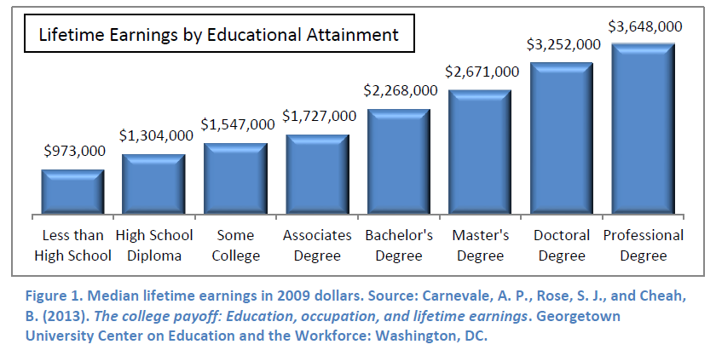
Lifetime earnings by educational attainment

Slide 28
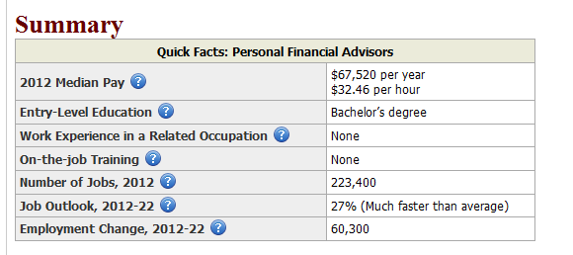
Example of a Professional Degree—Financial Planning (Bureau of Labor Statistics, 2014)
http://www.bls.gov/ooh/business-and-financial/personal-financial-advisors.htm#tab-1

Slide 29

Basic Computation of the Value of Human Capital
Where,
C=Annual income
I=Inflation or rate of increase of income
N=Number of periods

Slide 30
The Importance of financial knowledge
Most people are not very good at exchanging their human capital for financial capital
The more efficiently a person can exchange their human capital for financial capital, greater is the wealth they can accumulate across time
  Financial knowledge and financial capability is critical for this to happen

Slide 31
More on Saving
How much should we be saving?
  Depends on our financial goal and our time horizon
Short term savings goals
  Emergency funds
Long-term goals
  Retirement accounts
  Retirement plans
  Investment accounts/Brokerage accounts

Slide 32
How much should be kept aside as emergency funds?
Conventional Wisdom
  Having three to six months of income set aside in an emergency fund
Household Finance Research findings
  Varies by profession and source of income
    For self-employed individuals the best amount might be closer to six or even twelve months of income in an emergency fund
  For those on regular salaried employment, more recently it has been taking about 20 weeks (5 months) to find an equivalent job

Slide 33
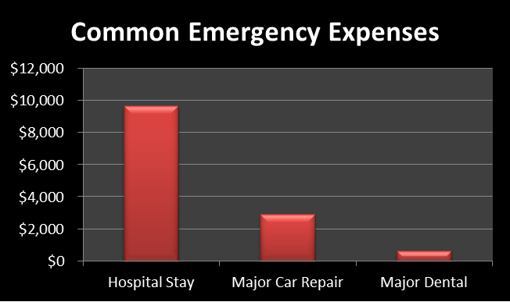
Common large scale budget breaking expenses aside from job loss

Slide 34
How to build an emergency fund?
Setting aside a small amount of money each pay period is the best way to build an emergency fund
Having access to affordable credit (low-rate credit card without a balance) can also provide needed liquidity in an emergency until you have had time to save sufficient money
Because emergencies do not come every year, many individuals find that a combination of emergency funds and low cost access to credit provide the best protection against unexpected events
For example, if your monthly income were $2,000, then you should have access to about $6,000 in case of an emergency
  This could consist of $1,500 in savings, plus an unused $4,500 credit line.

Slide 35
Where to save for your emergency funds
Keeping it at home is an option
  Risks involve safety and security risk, temptation to use the money, does not grow
Savings account
  Interest bearing account
  Safe & secure
  Any savings account that you open with a bank or credit union is insured by the Federal Deposit Insurance Corporation (FDIC) or the National Credit Union Association (NCUA)
  Risk: Can be easily accessed & does not protect the investor against the temptation of using the money for a non-emergency consumption

Slide 36
Resource: Review Exercise
Opportunity Cost | 1. Insures deposit accounts at banks against loss if the bank becomes insolvent.
B. Money market account | 2. An interest bearing account providing depositors a safe and secure place for money.
C. National Credit Union Association | 3. The foregone benefit that you would get from doing the next best thing.
D. Certificate of Deposit | 4. A savings account that restricts withdrawals from the account until a specific date; in exchange, the depositor receives a higher interest rate.
E. Federal Deposit Insurance Corporation | 5. An account that pays higher interest rates than a savings account.
F. Savings Account | 6. Insures deposit accounts at credit unions against loss if the credit union becomes insolvent.

Slide 37
Equitization of Emergency Funds
Another method to save and protect your investments that has become popular of late is the equitization of emergency funds
  Holding your savings as investments
    Preferably in a tax advantaged account like the Roth IRA
    Or a taxable account such as a brokerage account

Slide 38
How to open a Roth IRA?
Most banks and credit unions will be able to set up a ROTH IRA account at their institution
  Some of these ROTH IRA accounts may be limited to one or two types of investments, a CD or money market fund
Investment companies, also assist individuals in opening and contributing to ROTH IRAs
  www.vanguard.com
  www.fidelity.com
  www.charlesschwab.com

Slide 39
Other resources for beginning Investors
https://www.loyal3.com/

