Slide 1

ACEND® 2017 Accreditation Standards Overview
For Faculty and Preceptors
Notes:
Welcome to the ACEND 2017 Accreditation Standards Overview for Faculty and Preceptors. I am Cheryl Williams, one of the ACEND Managers of Education Program Accreditation. This training is intended as a supplement to faculty and preceptor trainings provided by ACEND-accredited programs as an orientation to ACEND and the role of faculty and preceptors in the accreditation process. This training, used in conjunction with a program-led review of the ACEND-required knowledge and competencies, will assist programs in being compliant with 2017 ACEND Accreditation Standard 7.

Slide 2
Objectives
As a result of completing this training, you should be able to do the following:
  Explain ACEND’s relationship to the Academy of Nutrition and Dietetics and its role in the accreditation process
  Describe the roles of the program director, faculty and preceptors in the accreditation process
  Identify key ACEND 2017 Accreditation Standards and Required Elements that are relevant to faculty and preceptors
©ACEND 2019
Notes:
As a result of completing this training, you should be able to:
Explain ACEND’s relationship to the Academy of Nutrition and Dietetics and its role in the accreditation process
Describe the roles of the program director, faculty and preceptors in the accreditation process, and
Identify key ACEND 2017 Accreditation Standards and Required Elements that are relevant to faculty and preceptors

Slide 3
Academy Relationships
Academy of Nutrition and Dietetics
ACEND
BOD
CDR
BOD
CDR
ACEND
Accreditation Council for Education in Nutrition and Dietetics
Board of Directors
Commission on Dietetic Registration
Accrediting Agency for Nutrition and Dietetics Education Programs
Professional Membership Organization
Credentialing Agency for Nutrition and Dietetics Practitioners
Notes:
ACEND stands for The Accreditation Council for Education in Nutrition and Dietetics. ACEND is the accrediting agency for education programs preparing students to begin careers as registered dietitian nutritionists or nutrition and dietetics technicians, registered.
I want to take a moment to explain ACEND’s relationship to the Academy of Nutrition and Dietetics. The Academy is a legally incorporated, not-for-profit corporation. It is a professional membership organization that provides products and services to its members and strives to empower members to be food and nutrition leaders. The Board of Directors oversees the strategic direction, budget, guidelines and policies of the Academy of Nutrition and Dietetics.
ACEND, although a part of the Academy’s not-for-profit corporation, is required by the US Department of Education to function autonomously from both the Academy and the Commission on Dietetic Registration, or CDR. All decisions made about accreditation standards and accreditation status are made by the ACEND Board without interaction or influence by either the Academy or CDR.
The Commission on Dietetic Registration is the credentialing agency for nutrition and Dietetics Practitioners and is part of the Academy’s not-for-profit corporation. CDR also functions autonomously from the Academy and ACEND in making credentialing decisions.

Slide 4
About ACEND
Fast Facts
USDE recognizes ACEND as the accrediting body for nutrition and dietetics education programs
ACEND assures the quality of nutrition and dietetics education through a peer review process
All accreditation decisions are made by a board of directors, comprised of educators, practitioners, student members and public members
©ACEND 2019
Notes:
Let’s discuss ACEND’s role in the accreditation process. ACEND is recognized by the US Department of Education, or USDE, as the accrediting body for nutrition and dietetics education programs. That means that ACEND is approved to create a set of standards that programs must follow in order to be considered an accredited program. Every five years the USDE reviews ACEND to ensure that it is meeting the USDE criteria for accreditors. Similarly, ACEND reviews its own accredited programs every seven years to ensure that they meet the ACEND standards. ACEND uses a peer-review process to assure the quality its programs. ACEND program review teams conduct site visits to programs who want to continue their accreditation, in order to assess whether those programs meet the ACEND Accreditation standards. The ACEND board of directors, comprised of educators, practitioners, student members and public members, review the recommendations from these teams and make all accreditation decisions as a group.

Slide 5
Role of Program Director
Manages compliance with ACEND requirements
Delegates data collection to faculty and preceptors
Compiles and analyzes student outcome data
Coordinates submission of all ACEND reports
Ensures faculty and preceptors are appropriate for subject area
Ensure faculty and preceptors are trained on program procedures and ACEND standards
©ACEND 2019
Notes:
I would like to summarize the roles that the Program Director, faculty and preceptors play in ACEND accredited programs. Program directors manage all of the duties related to maintaining compliance with the ACEND standards, but may delegate tasks such as data collection to faculty and preceptors. Program directors must ensure faculty and preceptors have adequate knowledge of the topics they teach, as well as understand program policies and the ACEND standards. They are also responsible for reporting data to ACEND annually and at the end of the program’s seven year accreditation cycle. Required Element 1.5 lists more Program Director duties in detail.

Slide 6
Role of Faculty and Preceptors
“Boots on the Ground”
Implement and assess specific assignments and activities in courses or rotations
Track student outcomes on specific assignments and provide data to program director
Participate in trainings provided by program
Provide program director with CV or other professional information to confirm experience
Include knowledge requirements and competencies on syllabi and rotation descriptions
©ACEND 2019
Notes:
Faculty and Preceptors are the “boots on the ground” for a program. That is to say, faculty and preceptors implement many of the learning experiences that allow students or interns to gain ACEND-required knowledge and skills throughout the program. Program Directors rely on faculty and preceptors to conduct fair assessments of their students and interns, alert the Program Director to any problems and track outcomes on certain assignments to help the program director demonstrate student achievement. There are also small administrative tasks, such as providing a CV or ensuring knowledge and competencies are included on course or rotation syllabi, that help the program stay in compliance with the ACEND standards,

Slide 7
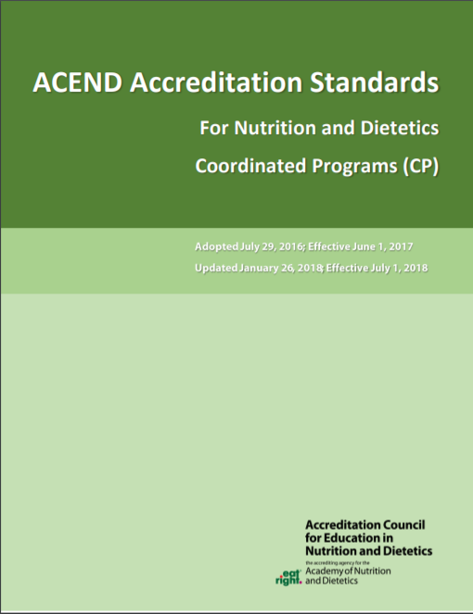
2017 ACEND Accreditation Standards
Standard and Required Elements
1: Program Characteristics and Resources
2: Consortia
3: Program Mission, Goals and Objectives
4: Program Evaluation and Improvement
5: Curriculum and Learning Activities
6: Student Learning Outcomes Assessment and Curriculum Improvement
7: Faculty and Preceptors
8: Supervised Practice/Experiential Learning Sites
9: Information to Prospective Students and the Public
10: Policies and Procedures
©ACEND 2019
Notes:
Here is a list of all ACEND 2017 Accreditation Standards. Most standards have the same components--A number, title and text of the standard and subtopics under each standard called Required Elements
The bolded standards, Standards 5, 6 and 7, have the most relevant information for faculty and preceptors. I will review these standards in detail. If you have questions on the other standards, please contact your program director.

Slide 8
Standards
Define minimum levels of quality
Basis for accreditation decisions
Applied equally to all programs
Revised on a routine basis
2017 Standards implementation: June 1, 2017
Revised 2017 Standards implementation: July 1, 2018
©ACEND 2019
Notes:
The Accreditations Standards are central to the accreditation process. These standards define the minimum levels of quality allowed for an accredited program in good standing. All accreditation decisions are made by the ACEND Board and are based on the Standards; they are applied equally to all programs.
The ACEND standards were created by educators, regulators, practitioners, students and the general public. They are revised on a routine basis, generally every five years, or more often as needed. The 2017 Accreditation Standard were implemented June 1, 2017 and were most recently revised to go into effect July 1, 2018.

Slide 9
Abbreviations
CRDN – Competencies for Registered Dietitian Nutritionist (CP, DI, FDE, IDE)
KRDN – Knowledge for Registered Dietitian Nutritionist (CP, DPD, FDE, IDE)
CNDT – Competencies for Nutrition and Dietetic Technicians, Registered (DT)
KNDT – Knowledge for Nutrition and Dietetic Technicians, Registered (DT)
SLO – Student Learning Outcomes
https://www.eatrightpro.org/ACEND
Notes:
Before I discuss the 2017 ACEND Accreditation Standards 5 and 6, I’d like to review a few abbreviations that you will hear in this presentation. Knowledge and Competencies are the core items that must be included in an ACEND-accredited Nutrition and Dietetics Education program curriculum. These knowledge and competencies are different between RDN and NDTR programs, and therefore have different abbreviations. RDN programs use CRDN and KRDN, and NDTR programs use CNDT and KNDT. SLO stands for Student Learning Outcomes. These are the data that demonstrate whether students are achieving the ACEND-required knowledge and competencies. For more information about these terms and other terms associated with accreditation, please visit ACEND’s website listed on this slide. The Guidance Information for ACEND 2017 Accreditation Standards not only includes information about the standards, but also contains a glossary. In our discussion of Standard 5, I will provide more details about knowledge and competencies and student learning outcomes in Standard 6.

Slide 10
Standard 5
Curriculum and Learning Activities
Required Element 5.1: Curriculum Components
Required Element 5.2: Curriculum Map
Required Element 5.3: Learning Activities
©ACEND 2019
Notes:
Standard 5 contains all of the requirements for an ACEND-accredited program’s curriculum. I will discuss each required element in this standard, as Faculty and Preceptors are the primary individuals responsible with implementing curriculum.

Slide 11
Standard 5
Curriculum and Learning Activities
Required Element 5.1: Curriculum Components
  Knowledge and skills needed to enter supervised practice or become an entry-level practitioner
©ACEND 2019
Notes:
Required Element 5.1 contains all of the topics and skills that must be included in the curriculum of an ACEND-accredited program. The program’s curriculum must be designed to ensure the breadth and depth of requisite knowledge and skills needed for: entry-level practice as a registered dietitian nutritionist (CP, ISPP, DI, IDE); nutrition and dietetics technician, registered (DT); dietitian (FDE); entry to supervised practice to become a registered dietitian nutritionist for (DPDs)

Slide 12
Curriculum Depth and Breadth
Required Element 5.1
Required Components (5.1.a)
  Broad topics, foundation of curriculum
Core Knowledge and Competencies (5.1.a)
  Specific pieces of knowledge and actionable skills that must be assessed (KRDNs, CRDNs, KNDTs and CNDTs)
Concentrations (5.1.b)
  Focus areas for RDN supervised practice
©ACEND 2019
Notes:
There are the three items in Required Element 5.1.
First are Required Components. These are broad topics that make up the foundation of an ACEND-accredited classroom curriculum. These topics can be covered in prerequisite courses, non-program courses or professional courses or in supervised practice. The required components piece does not need to be incorporated into DI programs.
Next are Core Knowledge and Competencies, also known as the KRDNs, CRDNs, KNDTs and CNDTs. These are specific pieces of knowledge and actionable skills that students and interns must learn and then be assessed on for proficiency. Before completing the program, a student MUST demonstrate the achievement of each required knowledge and/or competency, depending on the program type.
Finally, the ACEND standards require supervised practice programs such as DIs, CPs, or ISPPs to establish an area of concentration. Concentrations are focus areas determined by the program director for RDN supervised practice programs. Depending on your specialty as a faculty member or preceptor, you may be asked to include activities in your course or rotation that give students and interns a greater depth of experience within that concentration area to achieve specific concentration competencies. The program must include at least two program specific competencies with associated learning activities.

Slide 13
Curriculum Depth and Breadth
Required Element 5.1
Faculty
  Required Components
  Core Knowledge (KRDNs, KNDTs)
Preceptors
  Competencies (CRDNs, CNDTs)
  Concentrations
©ACEND 2019
Notes:
Generally, faculty are responsible for teaching the broad topics included in the required components and the core knowledge required by ACEND. Preceptors generally cover the ACEND-required competencies and the competencies that the program creates for their concentrations.

Slide 14
Curriculum Depth and Breadth
Required Element 5.1
Faculty
  Alternate Supervised Practice Hours
    Using role play, case studies, simulation or non-professional work site activities to achieve competencies
    CP, DT, degree-based DI only
©ACEND 2019
Notes:
There are some exceptions to this rule if program directors decided to use alternate supervised practice hours. Alternate supervised hours use activities outside of a supervised practice setting, such as role play, case studies and simulations that enable students to learn skills to achieve competencies. Faculty of CP, DT, or DI programs attached to a degree may be asked to include these activities in course work. Make sure to ask your program director to clarify if this is the case in your program.

Slide 15
Standard 5
Curriculum and Learning Activities
Required Element 5.2: Curriculum Map
How is the curriculum organized?
Where are the knowledge requirements and competencies assessed in the curriculum?
©ACEND 2019
Notes:
Required Element 5.2 enables programs to establish how their curriculum is organized and where the knowledge requirements and competencies are assessed in the curriculum.

Slide 16
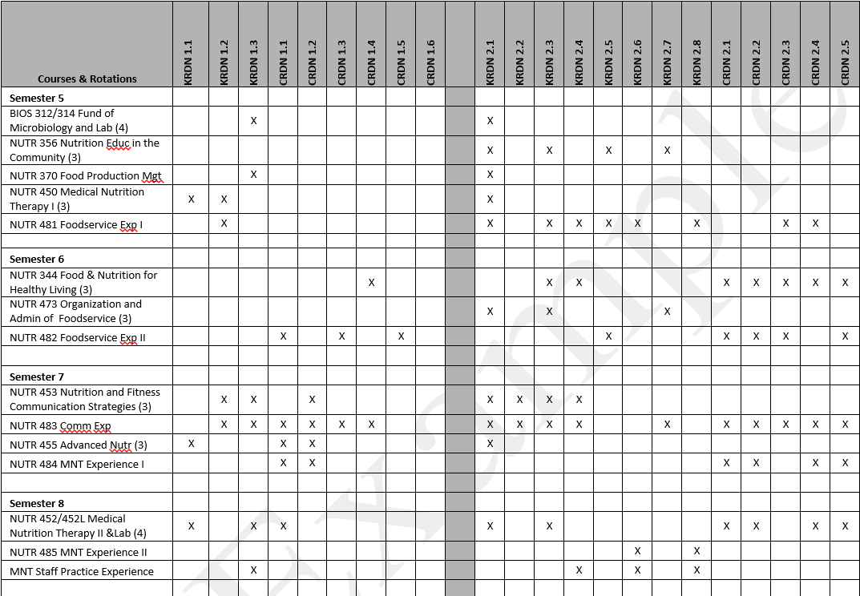
Curriculum Map
Required Element 5.1
REQUIRED TEMPLATE for ALL PROGRAMS
©ACEND 2019
Notes:
Some program directors may share with you, or ask your help in updating, the curriculum map for the program. The curriculum map shows where each KRDN, CRDN, KNDT or CNDT are addressed in the curriculum. All programs are required to submit this template to ACEND in various reports.

Slide 17
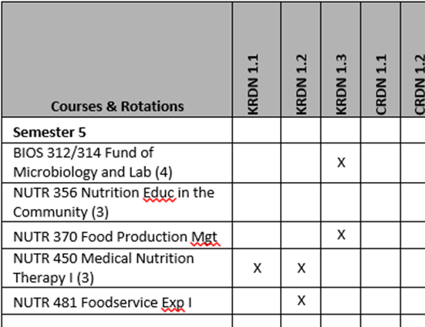
Curriculum Map
Required Element 5.1
REQUIRED TEMPLATE for ALL PROGRAMS
©ACEND 2019
Notes:
As you can see, courses and rotations are listed in sequential order and program directors mark where the knowledge and competencies are addressed. Program director may reach out to faculty, staff and preceptors to confirm which knowledge and competencies are included in your instruction or supervised practice rotation. Additionally, ACEND requires that course syllabi and rotation descriptions include the KRDNs, CRDNs, KNDTs or CNDTs with the associated learning activity that are addressed in the course or rotation. Program directors appreciate the support from faculty and preceptors to meet this requirement.

Slide 18
Standard 5
Curriculum and Learning Activities
Required Element 5.3: Learning Activities
  Various conditions and disease states
  Various populations, including specific age groups
  Diverse cultures
  Variety of educational approaches
©ACEND 2019
Notes:
Required Element 5.3 describes what types of learning activities are required by ACEND. Program directors must ensure students learn about a variety of conditions and disease states, populations and cultures within the curriculum. Additionally, programs must include a variety of educational approaches, such as case studies, interdisciplinary team work and hands-on skill building when teaching students and interns, to facilitate learning for individuals with different learning needs.

Slide 19
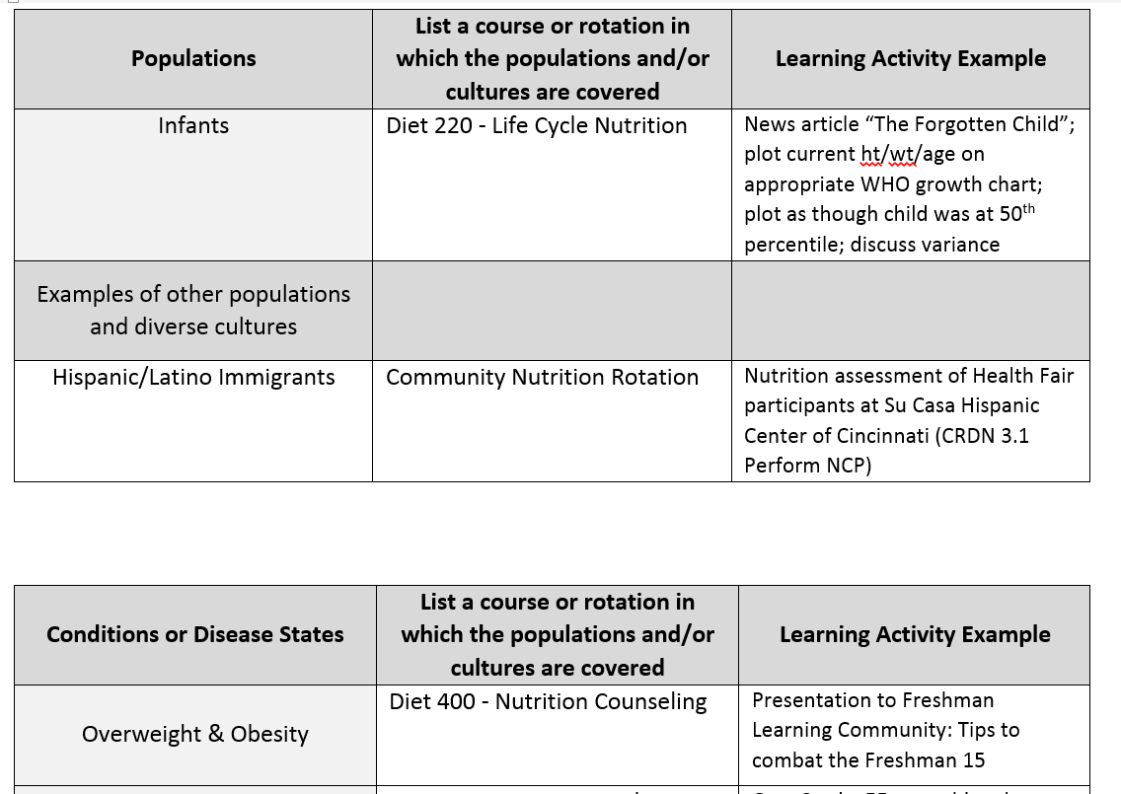
Required Element 5.3
Summary of Learning Activities Template
REQUIRED TEMPLATE
©ACEND 2019
Notes:
ACEND requires that programs submit a summary of these learning activities in a required template. The program director may ask faculty and preceptors for examples of a learning activity from your course or rotation that is associated with a population or disease state, or request that you include a specific activity within your course or rotation so that all students or interns are exposed to the same information or skill building. Program directors appreciate the support of faculty and preceptors in helping to meet this requirement.

Slide 20
Standard 5
What to Expect from Program Director
Faculty:
Discussion of learning activities to assess knowledge (KRDN, KNDT)
Explanation of any competencies (CRDN, CNDT) covered
Preceptors:
Program-specific Rotation Description (or help creating)
Program-specific rubrics/assessment materials
Discuss student and preceptor expectations
©ACEND 2019
Notes:
The program director should be in regular communication with the faculty and preceptors participating in the education of program students. If you are a faculty member of the program, you should expect the program director to discuss the following with you:
-Any learning activities from your course used to assess KRDNs or KNDTs, and
-Whether activities in your course will be included as alternate supervised practice hour activities to assess the CRDNs or CNDTs.
If you are a preceptor, program directors must provide a program-specific rotation description and assessment materials for the students you are training. In some cases, a preceptor may be working with the program director to create these rotation descriptions and assessment materials. The program director and preceptor should also discuss what is expected of both the student or intern and the preceptor during the rotation so that the appropriate student or intern experience is provided. It is important that each program provide its own materials to preceptors. Preceptors who are precepting students from multiple programs, must use the assessment materials from the program a student attends, not materials from any other institutions they may be working with.

Slide 21
Standard 6
SLO Assessment and Curriculum Improvement
Required Element 6.1: Student Learning Outcome (SLO) Assessment
Required Element 6.2: SLO Data Collection
Required Element 6.3: Qualities of formal curriculum review
©ACEND 2019
Notes:
Standard 6 includes requirements for how programs must assess their curriculum to make sure that their students are achieving the required knowledge and competencies.

Slide 22
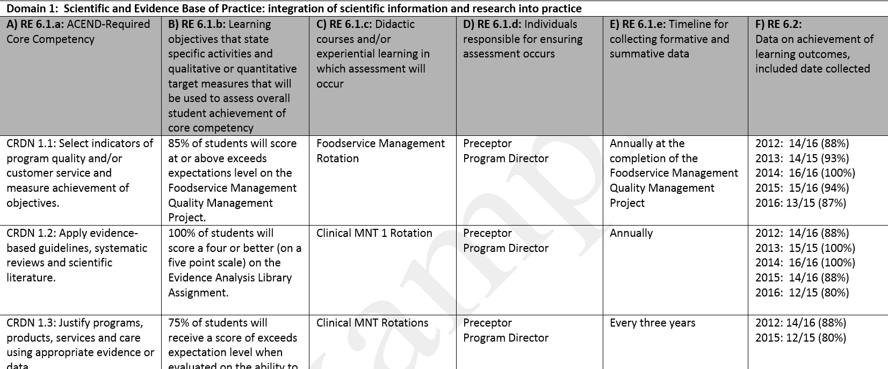
Standard 6
SLO Assessment and Curriculum Improvement
Required Element 6.1: Student Learning Outcome (SLO) Assessment
©ACEND 2017
Notes:
Required Element 6.1 describes the Student Learning Outcomes, or SLO, Assessment Plan. You may have seen this document if you are helping the program director plan or collect assessment data. The program director must choose one assessment method per knowledge requirement or competency to measure whether students or interns are achieving the required knowledge and competencies. In this plan they also much describe what course or rotation this assessment method occurs, who will be assessing the student or intern, and when the collection of that data will take place. If you do not know whether the course or rotation you lead contains an assessment method that is listed on the SLO, please check with your program director. SLOs that related to the required knowledge may be collected from faculty or instructors by the program director. Generally SLOs are assessed by preceptors during rotation for CPs, DIs, ISPPs and DTs and not coursework since these types of programs only assess the competency statements.

Slide 23
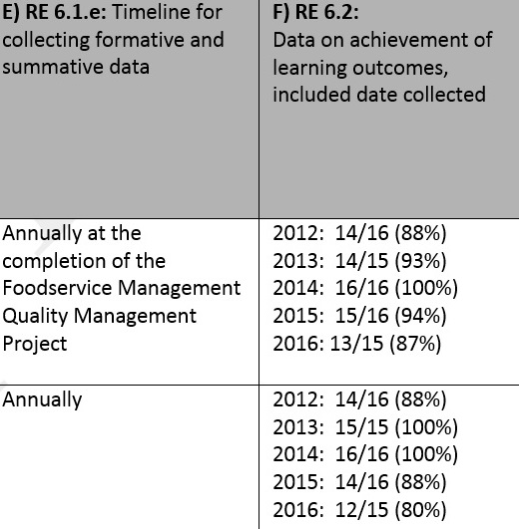
Standard 6
SLO Assessment and Curriculum Improvement
Required Element 6.2: SLO Data Collection
©ACEND 2019
Notes:
Required Element 6.2 addresses the last column of the SLO Assessment Plan. This is where program directors list the data collected for each assessment method over the last accreditation cycle, which is 7 years. If you are collecting data for an assignment or activity that is used in the SLO plan, this is where your data is provided to ACEND.

Slide 24
Standard 6
SLO Assessment and Curriculum Improvement
Required Element 6.3: Qualities of formal curriculum review
©ACEND 2019
Notes:
Required Element 6.3 mandates that programs analyze SLO data, as well as feedback from students and other stakeholders, identify strengths are areas of improvement for the program and then develop actions that will be taken to improve the program based on this analysis. You may be asked to provide feedback about the program’s curriculum or, if you are part of a curriculum committee or advisory board for the program, to review feedback and assist with data analysis.

Slide 25
Standard 6
What to Expect from Program Director
Identification of SLO assessment methods in your course or rotation
Correspondence about collecting data
Request for feedback about curriculum
©ACEND 2019
Notes:
The program director should reach out to you to discuss what assignments or activities that will be used to assess SLOs within the course or rotation that you lead, as well as details about data collection. The program director may also request your feedback about the program’s curriculum.

Slide 26
Standard 7
Faculty and Preceptors
Required Element 7.1: Qualified Faculty and Preceptors
Required Element 7.2: Continued Competency and Evaluation
Required Element 7.3: Orientation and Training Requirements
©ACEND 2019
Notes:
Standard 7 discusses requirements around faculty and preceptors. Please pay special attention to this standard—it’s all about you!

Slide 27
Standard 7
Faculty and Preceptors
Required Element 7.1: Qualified Faculty and Preceptors
  Faculty and preceptors do not need to be RDNs or NDTRs, if experience and credentialing are appropriate
©ACEND 2019
Notes:
Required Element 7.1 states: “The program must provide evidence that qualified and appropriately credentialed faculty and preceptors are sufficient to ensure implementation of the program’s curriculum and the achievement of the program objectives and student learning outcomes”. Not all faculty and preceptors need to be RDNs or NDTRs, but they need to be appropriately credentialed in the area they’re teaching. For example, a nurse who is a certified diabetes educator would be an appropriate preceptor in an outpatient diabetes clinic, but probably not in the NICU. The program director may ask for evidence of your credentialing in order to demonstrate compliance with this required element.

Slide 28
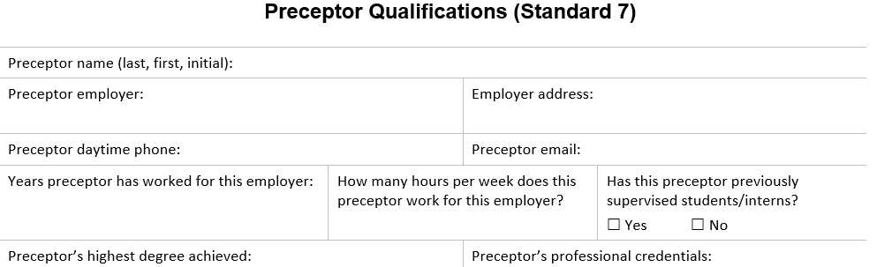
Standard 7
Faculty and Preceptors
Required Element 7.2: Continued Competency and Evaluation
©ACEND 2019
Notes:
Required Element 7.2 states that faculty and preceptors must meet university or hospital rules for appointment to their positions. Additionally, preceptors must have appropriate licensure and/or credentialing for their position and meet any state or federal regulations. Both faculty and preceptors must show that they are maintaining their knowledge of the area in which they teach or precept through continuing education. This is different than just maintaining credentialing and licensure; faculty and preceptors must show that they have the most recent knowledge in the topic they are teaching. Finally, faculty and preceptors must be reviewed periodically by the program, including input by students and interns.
To show compliance with this required element, your program director may ask you to provide an updated resume that includes a list of recent continuing education that you have participated in. Alternatively, they may ask that you fill out a preceptor qualification form, like the one pictured on this slide. A copy of the preceptor’s CDR card or state licensure certificate is not acceptable evidence, as it does not show that the continuing education is used to maintain credentialing and licensing in the topic area in which the preceptor teaches. Program directors appreciate cooperation from faculty and preceptors to provide this information in order to demonstrate compliance with this requirement.

Slide 29
Standard 7
Faculty and Preceptors
Required Element 7.3: Orientation and Training Requirements
Program’s mission, goals and objectives
Program's education philosophy
ACEND Standards and required knowledge and competencies
Training based on program evaluation and input from students or interns
©ACEND 2019
Notes:
Required Element 7.3 states that faculty and preceptors must be trained on the program’s mission, goals and objectives, the program’s educational philosophy, as well as the ACEND standards and curriculum requirements. This training helps the program meet this required element. Required Element 7.3 also states that the program must identify areas of training needed from faculty and preceptor evaluations and use that information to provide training for faculty and preceptors in the future. The goal of this training is to ensure continued competence and improvement among all those who participate in teaching students and interns.

Slide 30
Standard 7
What to Expect from Program Director
Request for resume
Request for recent continuing education endeavors
Training Materials
  Review of Program mission, goals and objectives
  Review of ACEND and Standards
  Explanation of CRDNS/CNDTs
Preceptor Handbook
©ACEND 2019
Notes:
To summarize, you can expect your program director to reach out to you periodically to request an updated resume and a list of recent continuing education. You program director should also be providing periodic training materials, especially if there are any changes to the ACEND standards or curriculum requirements, or changes to the program. Finally, your program director may provide you with a preceptor handbook that explains expectations of program preceptors; however, this handbook is not required.

Slide 31
For more information
Visit the ACEND Website for:
  2017 ACEND Accreditation Standards
  Guidance Information
  Listing of accredited programs
  Updates about accreditation
  Accreditation Modules (7 CEUS)
  http://www.eatrightpro.org/acend
©ACEND 2019
Notes:
That completes this overview of ACEND for faculty and preceptors. Again, if you would like to learn more about the accreditation process and the ACEND accreditation standards, please visit our website. You can access our standards documents and site visit Guidance Information, as well as a listing of ACEND accredited programs and the latest news from ACEND. If you would like more information on the accreditation process, you can visit the Training section of our website, where you can complete ACEND’s accreditation modules for 7 CEUs.

Slide 32
Thank you!
ACEND’s contact information:
Email: ACEND@eatright.org
Phone: 800/877-1600, ext. 5400
Mail: 120 South Riverside Plaza
Suite 2190, Chicago, IL 60606-6995
ACEND Website: http://www.eatrightpro.org/acend
Notes:
Thank you for participating in this training. If you have any questions, comments or concerns, please contact ACEND.

